Slide 1
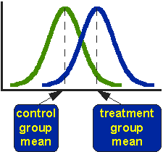
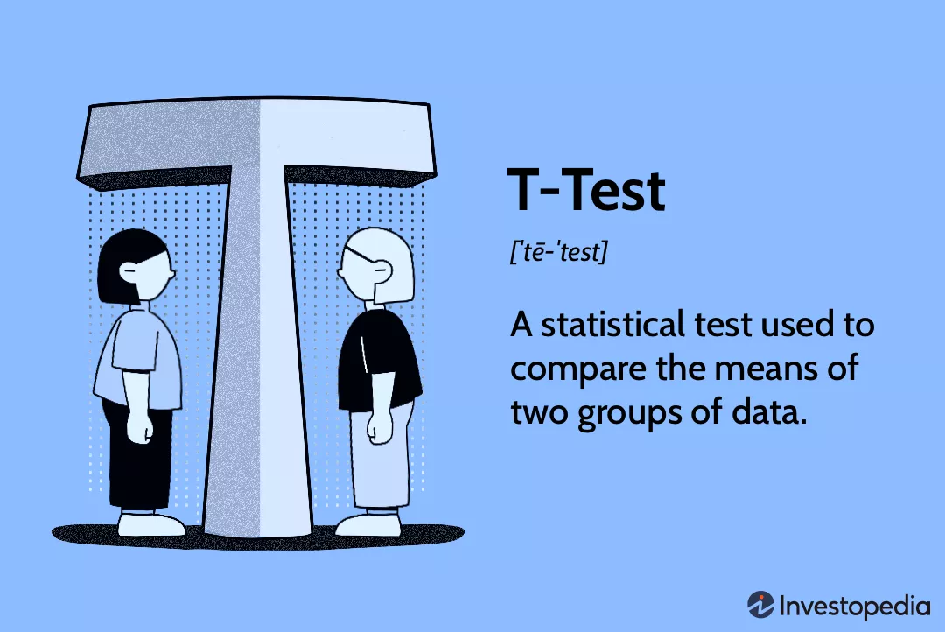
UIT2502 – Data Analytics & Visualization
Analysis of Variance - T-test

Slide 2
T-Test Introduction
A t-test is an inferential statistic used to determine if there is a significant difference between the means of two groups and how they are related.
T-tests are used when the data sets follow a normal distribution and have unknown variances.
Parameters to determine statistical significance:
t-statistic, the t-distribution values, and the degrees of freedom

Slide 3
Understanding T-Test
A t-test compares the average values of two data sets and determines if they came from the same population.
Examples:
Sample of students from class A and a sample of students from class B would not likely have the same mean and standard deviation.
Samples taken from the placebo-fed control group and those taken from the drug prescribed group should have a slightly different mean and standard deviation.

Slide 4
Setting H0 in T-Test
The t-test takes a sample from each of the two sets and establishes the problem statement.
It assumes a null hypothesis that the two means are equal.
Concept of degrees of freedom is introduced only because we are using observations in a sample to estimate some unknown characteristic of the population.

Slide 5
Assumptions
The data collected must follow a continuous or ordinal scale, such as the scores for an IQ test
The data is collected from a randomly selected portion of the total population
The data will result in a normal distribution of a bell-shaped curve, and
Homogenous variance exists when the standard variations are equal (Levene’s test ).
No significant outliers

Slide 6
Inference from T-test
Decision
 | Sample Good | Sample bad
Good batch of items | Accept the lot Correct Decision | Reject the lot Wrong decision Type 1 Error
Bad batch of items | Accept the lot Wrong decision Type 2 Error | Reject the lot Correct decision

Slide 7
Inference from T-test
The comparison helps to determine the effect of chance on the difference, and whether the difference is outside that chance range.
The t-test questions whether the difference between the groups represents a true difference in the study or merely a random difference.

Slide 8
Inference from T-test
A large t-score, or t-value, indicates that the groups are different while a small t-score indicates that the groups are similar.
Degrees of freedom refer to the values in a study that has the freedom to vary and are essential for assessing the importance and the validity of the null hypothesis.
Computation of these values usually depends upon the number of data records available in the sample set.

Slide 9
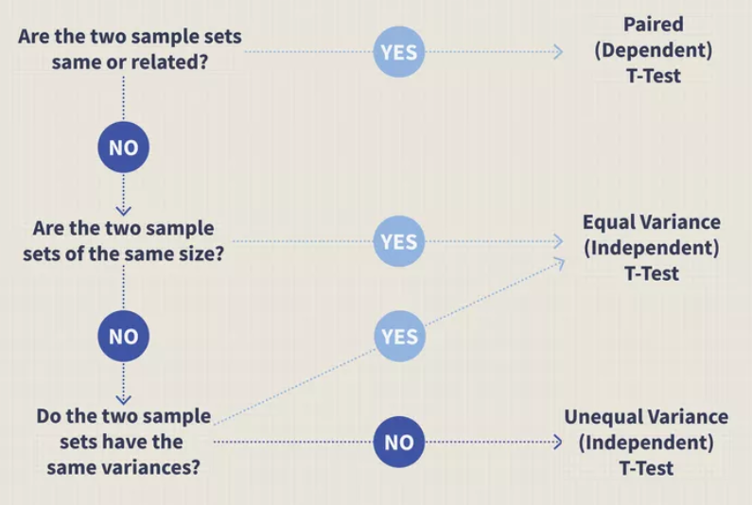
Types of T-Test
Image by Julie Bang Â© Investopedia 2019

Slide 10
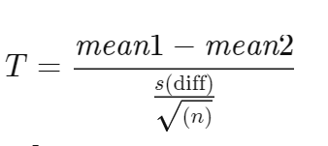
Paired/ Correlated Sample T-Test
A dependent type of test
Performed when the samples consist of matched pairs of similar units, or when there are cases of repeated measures.
For example, there may be instances where the same patients are repeatedly tested before and after receiving a particular treatment.
Each patient is being used as a control sample against themselves.
Degree of freedom is n-1

Slide 11
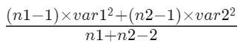
Equal Variance or Pooled T-Test
An independent t-test
Used when the number of samples in each group is the same, or the variance of the two data sets is similar.
Degree of freedom is n1+n2−2
where s is sqrt( )

Slide 12
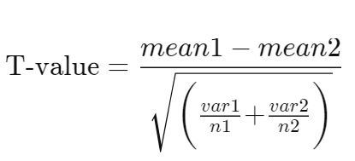
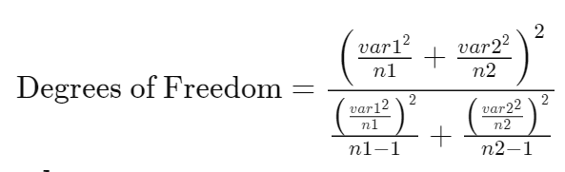
Unequal Variance/ Welch's T-Test
Independent t-test
Used when the number of samples in each group is different, and the variance of the two data sets is also different.

Slide 13
Is it Z-Test or T-Test?
Deciding parameters
Details about population parameters such as variance, std deviation
Size of the population (n>30 or n< 30)

Slide 14
Is it Z-Test or T-Test?
An automobile company is interested in testing the mileage given by one of the car brands in two different cities, Mumbai and Delhi. The company surveyed 100 car owner in Mumbai and found that the average mileage is 12kms. Per litre. Out of 150 car owner in Delhi, the mileage averaged to 12.5 kms per litre. The Standard deviation for mileage of this brand of car is known to be 0.9 kms. Can we state that these two cities give different mileage?

Slide 15
Is it Z-Test or T-Test?
An automobile company is interested in testing the mileage given by one of the car brands in two different cities, Mumbai and Delhi. The company surveyed 100 car owner in Mumbai and found that the average mileage is 12kms. Per litre. Out of 150 car owner in Delhi, the mileage averaged to 12.5 kms per litre. The Standard deviation for mileage of this brand of car is known to be 0.9 kms. Can we state that these two cities give different mileage?

Slide 16
Is it Z-Test or T-Test?
The owner of the workshop wants to know which of the 2 brands of hand gloves used in the workshop has longer lasting life than the other. He selected, at random 40 workers who wear gloves of National firm and their gloves lasted on an average for 80 days with s.d 50 days; while another 40 randomly selected workers wear out the gloves of Liberty firm on an average in 854 days with s.d 4.0 days. Can he feel 95% confident that the difference between the brands is significant?

Slide 17
Is it Z-Test or T-Test?
The owner of the workshop wants to know which of the 2 brands of hand gloves used in the workshop has longer lasting life than the other. He selected, at random 40 workers who wear gloves of National firm and their gloves lasted on an average for 80 days with s.d 50 days; while another 40 randomly selected workers wear out the gloves of Liberty firm on an average in 854 days with s.d 4.0 days. Can he feel 95% confident that the difference between the brands is significant?

Slide 18


T-test for One Sample
Hypothesis testing of mean
Population Standard deviation, σ, is unknown

Slide 19
Example
A car manufacturer claims that its new car gives a mileage of at least 10kms/ltr. A sample of 10 cars is taken, and their mileage recorded as follows (in km/ltr):
Is there any statistical evidence to support the claim of the manufacturer about the mileage of its car?
11.2 | 10.7 | 11.3 | 11.0 | 10.8 | 10.7 | 10.6 | 10.6 | 10.7 | 10.4

Slide 20
Example
A car manufacturer claims that its new car gives a mileage of at least 10kms/ltr. A sample of 10 cars is taken, and their mileage recorded as follows (in km/ltr):
Is there any statistical evidence to support the claim of the manufacturer about the mileage of its car?
Null hypothesis: H₀ : μ = 10
Alternative Hypothesis H_{α}: μ<10
level of significance: α=5%
11.2 | 10.7 | 11.3 | 11.0 | 10.8 | 10.7 | 10.6 | 10.6 | 10.7 | 10.4

Slide 21
The table t-value at 9 d.f is -1.83
Acceptance region should be greater than -1.83
The calculated value (8.94) is lies in acceptance region. So null hypothesis is accepted
There is statistical evidence to support the claim.

Slide 22
Example
The mean nicotine content of a brand of cigarette is 20.0 mgs. A new process is proposed to lower the nicotine content without affecting the flavour. To test the new process, 16 cigarettes are selected at random from the week’s output from the test plant. The sample mean nicotine content is found to be 18.5mg. If the s.d of nicotine contents is calculated to be 2 mgs, is the claim of the new process justified? Use 5% level of significance.

Slide 23
The table t-value at 15 d.f is -1.75
Acceptance region should be greater than -1.75
The calculated value (-3) lies in rejection region. So null hypothesis is rejected.
Interpretation: The sample shows the evidence that the mean nicotine contains in the cigarettes is less than 20mgms.

Slide 24
T-test for Two Sample

Slide 25
Is it Z-Test or T-Test?
A car manufacturer is procuring car batteries from two companies. For testing whether the two brands of batteries say A and B had the same life, the manufacturer collected data about the lives of both brand of batteries from 20 car owners- 10 using A brand and 10using B brand. The lives were reported as follows:
A | 50 | 61 | 54 | 60 | 52 | 58 | 55 | 56 | 54 | 53
B | 65 | 57 | 60 | 55 | 58 | 59 | 62 | 67 | 56 | 61

Slide 26
Is it Z-Test or T-Test?
A car manufacturer is procuring car batteries from two companies. For testing whether the two brands of batteries say A and B had the same life, the manufacturer collected data about the lives of both brand of batteries from 20 car owners- 10 using A brand and 10using B brand. The lives were reported as follows:
A | 50 | 61 | 54 | 60 | 52 | 58 | 55 | 56 | 54 | 53
B | 65 | 57 | 60 | 55 | 58 | 59 | 62 | 67 | 56 | 61

Slide 27
Is it Z-Test or T-Test?
A car manufacturer is procuring car batteries from two companies. For testing whether the two brands of batteries say A and B had the same life, the manufacturer collected data about the lives of both brand of batteries from 20 car owners- 10 using A brand and 10using B brand. The lives were reported as follows:
A | 50 | 61 | 54 | 60 | 52 | 58 | 55 | 56 | 54 | 53
B | 65 | 57 | 60 | 55 | 58 | 59 | 62 | 67 | 56 | 61
Null hypothesis: H₀: μ₁=μ₂
Alternative hypothesis: H_{α}: μ₁≠μ₂
Level of significance: α = 5%

Slide 28
T-test for Two Sample

Slide 29
Acceptance region: -2.101 and +2.101
Test statistics t @ n₁+n₂-2 i.e 18 d.f
Inference

Slide 30
Example
Five salesmen were imparted a one-week specialised training for improving their selling skills. The following data was recorded during the month preceding the training and the month after the training relation to their sales per month. Can we conclude that the training has made any significant impact.
Before (In lakhs) | 5 | 6.2 | 5.4 | 4.5 | 5.6
After (In lakhs) | 5.5 | 7.0 | 5.6 | 5.5 | 6.6

Slide 31
T-test for Two Sample

Slide 32
Example
Five salesmen were imparted a one-week specialised training for improving their selling skills. The following data was recorded during the month preceding the training and the month after the training relation to their sales per month. Can we conclude that the training has made any significant impact.
Before (In lakhs) | 5 | 6.2 | 5.4 | 4.5 | 5.6
After (In lakhs) | 5.5 | 7.0 | 5.6 | 5.5 | 6.6
Null Hypothesis: H0: μ1- μ2(after)= μ1(before)= μ2(after) (mean no significant change)
Alternative Hypothesis: H1: μ1≠ μ2 ( significant change)

Slide 33
Example – Paired T-Test
Before | After | di (before - after) | (di-d‾) | (di-d‾)²
5 | 5.5 | -0.5
6.2 | 7 | -0.8
5.4 | 5.6 | -0.2
4.5 | 5.5 | -1
5.6 | 6.6 | -1
 | Sum | -3.5
 | d‾ | ?

Slide 34
Example – Paired T-Test
Decision rule??
S-value, t-value ??
Conclusion and inference

Slide 35
The t-distribution is more spread out and has heavier tails compared to the standard normal distribution.

Slide 36
t-distribution is more spread out
Greater variance compared to the standard normal distribution.
The values in a t-distribution are more variable and tend to be farther from the mean, resulting in a broader and more flattened shape of the probability density function (PDF) compared to the standard normal distribution.

Slide 37
t-distribution has heavier tails
It has a higher probability of extreme values (values far from the mean) compared to the standard normal distribution.
There is a greater likelihood of observing extreme values when working with a t-distribution, which makes it more robust in handling outliers in small sample sizes.

Slide 38
Books
TEXTBOOKS:
David Cielen, Arno D. B. Meysman, and Mohamed Ali, “Introducing Data Science”, Manning Publications, 2016. (first two chapters for Unit I).
Robert S. Witte and John S. Witte, “Statistics”, Eleventh Edition, Wiley Publications, 2017.
Jake VanderPlas, “Python Data Science Handbook”, O’Reilly, 2016.
REFERENCES:
Allen B. Downey, “Think Stats: Exploratory Data Analysis in Python”, Green Tea Press, 2014.

